Slide 1
HME Ticket System manual
○ Decision Making
● Information Sharing
○ Directions
Standard report template
27. July. 2023
Hyundai Motor Europe
IT Helpdesk Team

Slide 2
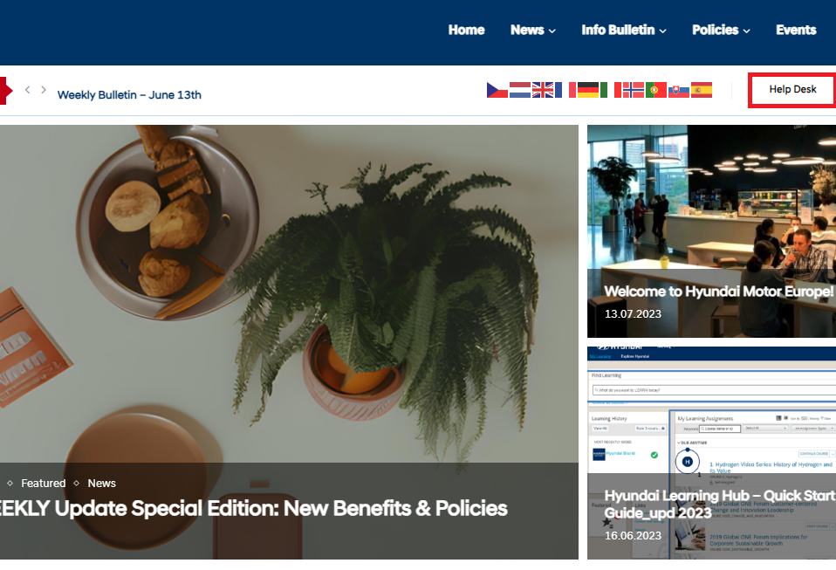

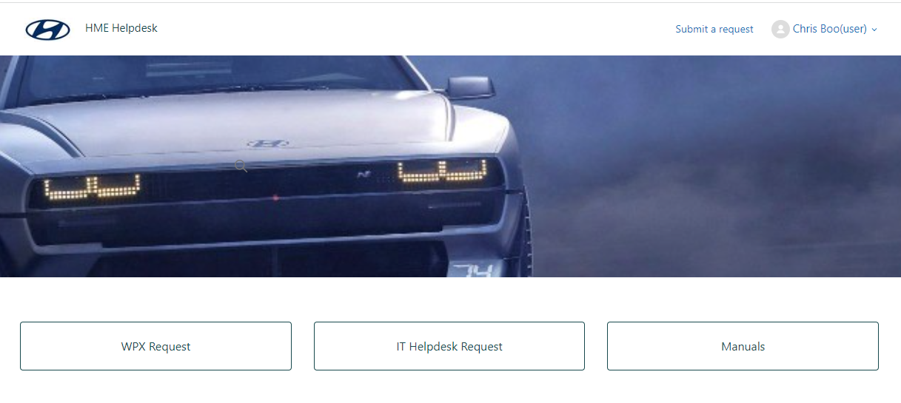
How to Submit a ticket
Go to HR-Portal ➔ Help Desk
or
https://hme-support.zendesk.com/
Submit a request without login

Slide 3
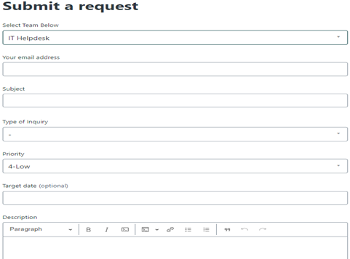
How to Submit a ticket
Create a ticket, filling out the form.
(Ensure to enter the company email address)

Slide 4
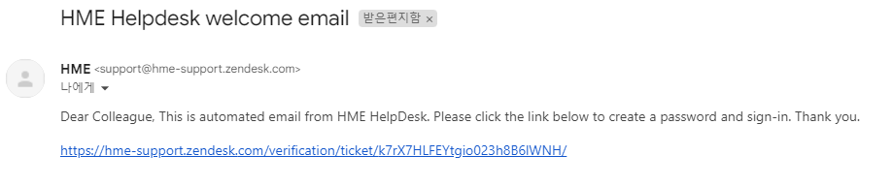
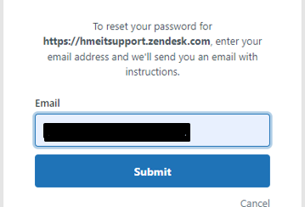
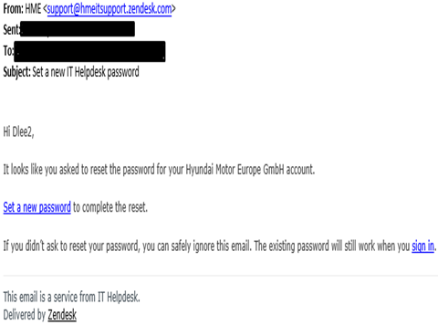
How to Register a user account
Once the ticket is created, you will receive an email like the one above. Click on the email link.
Enter your company email
Click on the link below to set a new password

Slide 5
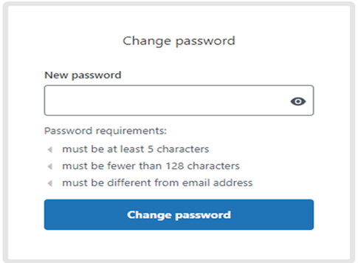
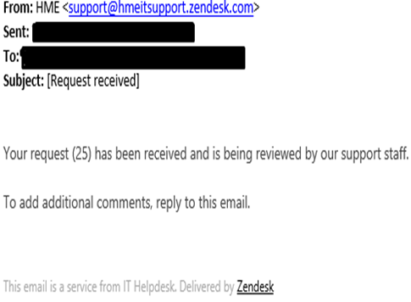
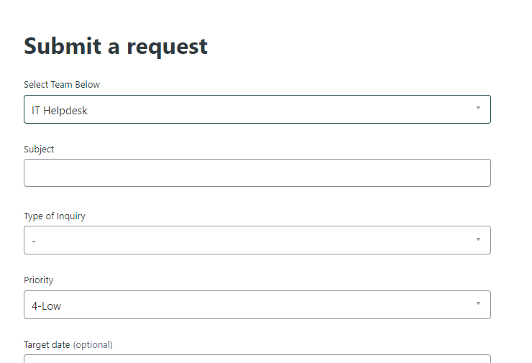
How to Register a user account
Change your password following the rules listed below.
After changing the password setting, you will receive an email notification.
Once all steps are successfully done, you can use the system without re-entering your email address.

Slide 6
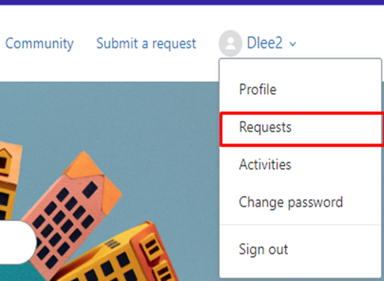
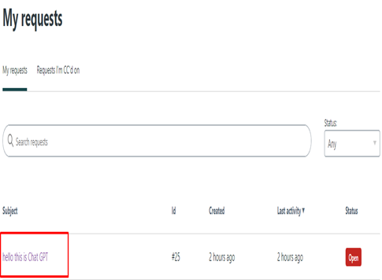
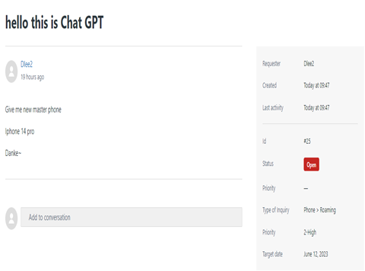
How to Track ticket status
By clicking on "Requests" below, you can check the status of the tickets you have created.
Click on the name of the ticket you have created below.
You can check the status and information.

Slide 7
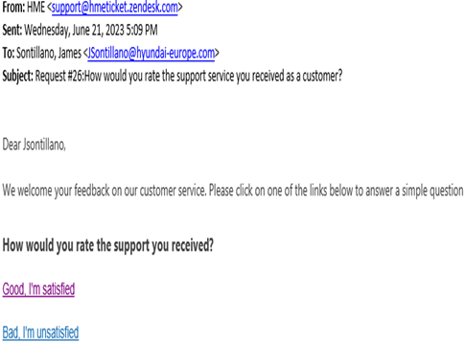
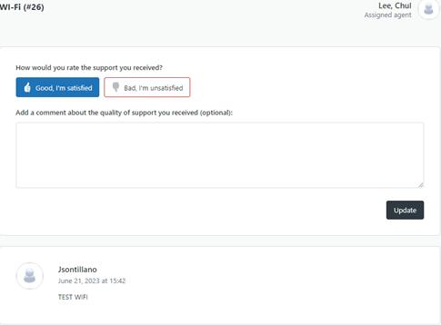
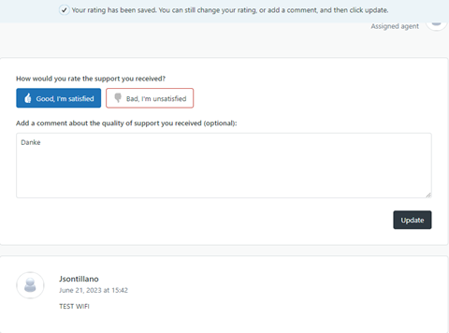
How to Survey the support
Once the ticket has been resolved, you will receive an email to rate the service. You can choose the options from “Good” or “Bad”.
By clicking the rating link, you can able to add comment as below.
Once you click “Update” than the survey has been finished.

