Slide 1

VPN Two Factor Authentication
Restricted
September, 2023

Slide 2
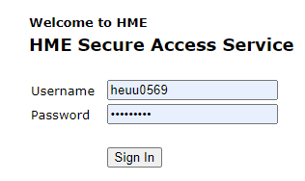
How to set up VPN 2FA (Two Factor Authentication)
사내한
RESTRICTED
Access the VPN URL through browser https://sslvpn.hyundai-autoever.eu/HME and enter your VPN credentials
Once you logged in, you’ll be redirected to a page which will have a QR code along with backup codes
Please securely store the backup codes in your secure vault
Keep the webpage with the QR Code open for the next steps

Slide 3

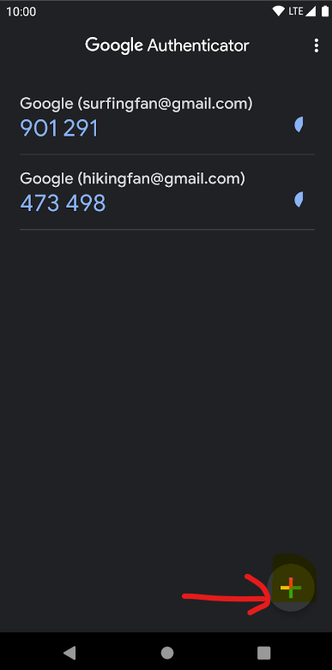
How to set up VPN 2FA (Two Factor Authentication)
사내한
RESTRICTED
Now on your mobile please go to Google Play Store (Android) / App Store (Apple IOS) and install the app “Google Authenticator”
Once Authenticator app gets installed, please open Google Authenticator
The app will ask you to sign in with a Google account → Right below, you have the option to “sign in without an account” – please choose this option
Then click the ‘+’ sign as shown on the right and select scan a QR code

Slide 4
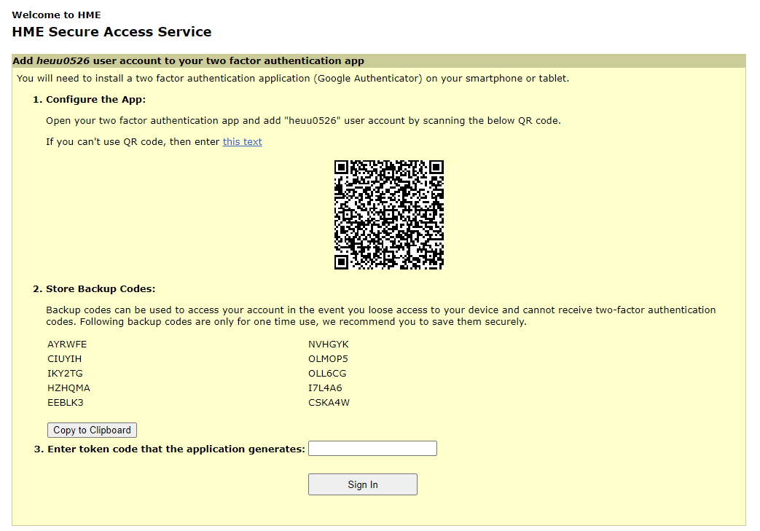
How to set up VPN 2FA (Two Factor Authentication)
사내한
RESTRICTED
Now Scan the QR code you’ve received in previous step with Google Authenticator app
Once you scan, you’ll see your account added into Google Authenticator App under the name
“sslvpn.hyundai-autoever.eu - HEUUXXXX” along with your VPN ID
Please enter the OTP you see under Google Authenticator app – a 6 digit code – and click Sign In
You’ll be signed into your VPN account now
← Illustrative only

Slide 5
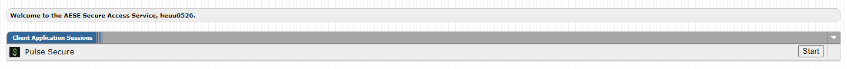
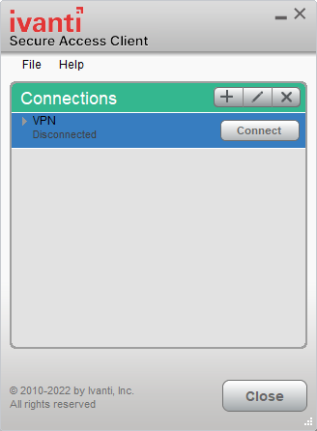
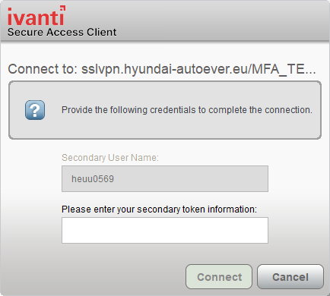
How to set up VPN 2FA (Two Factor Authentication)
사내한
RESTRICTED
VPN 2FA setup is simply done.
Now just close the browser and launch VPN program (ivanti Secure Access Client) to access VPN.
Please note that you don’t have to click anything in the browser.
Click ‘connect’ to connect your VPN.
You can enter token number (6 digits) using Google Authenticator App.

